Slide 1
GENETIC ALGORITHM BASED FEATURE SELECTION FOR THE CLASSIFICATION OF BREAST MASSES IN MAMMOGRAMS
Team Guide
Mr. V.Aravindarajan, AP/IT
Team Members:
Rakesh Prasanna R
Regn No: 910619205042

Slide 2
ABSTRACT
Cancer is one of the most dangerous diseases to humans, and yet no permanent cure has been developed for it.
Breast cancer is one of the most common cancer types.
According to the National Breast Cancer foundation, in 2020 alone, more than 276,000 new cases of invasive breast cancer and more than 48,000 non-invasive cases were diagnosed in the US.
It is very necessary to detect cancer at early stages.
Mammography is the most effective tool for early detection of breast cancer. Images taken from mammography are called mammograms
Mammogram images are collected from the publicly available dataset, Digital Database For Screening Mammography (DDSM)
This method employed Genetic Algorithm + KNN classifier combination for classification and to evaluate the performance some other classifiers are used and their results are compared

Slide 3
AIM
To classify the mammogram images into benign, malignant and normal image using genetic algorithm based feature selection technique and classify them using ML based algorithm with highest accuracy.

Slide 4
PROBLEM STATEMENT
The selection of optimal set of features for accurate classification of breast masses needs improvement

Slide 5
SYSTEM REQUIREMENTS The hardware and software requirements for the proposed system are presented as follows:
Hardware Requirements
PROCESSOR : | Pentium III & above
RAM : | 2GB
Software Requirements
OPERATING SYSTEM : | Windows 8
MATLAB VERSION : | Matlab R2014a

Slide 6
LITERATURE SURVEY
USMAN NASEEM1, JUNAID RASHID2, LIAQAT ALI3, JUNGEUN KIM 4, QAZI EMAD UL HAQ 5, MAZHAR JAVED AWAN 6, AND MUHAMMAD IMRAN 7 “An Automatic Detection of Breast Cancer Diagnosis and Prognosis Based on Machine Learning Using Ensemble of Classifiers “VOLUME 10, 2022
Breast cancer (BC) is the second most prevalent type of cancer among women leading to death This Paper presented an ensemble of machine learning-based methods for breast cancer diagnosis and prognosis using an ensemble of machine learning classifiers. A comprehensive comparison of the performance of various machine learning and ensemble machine learning-based classifiers were discussed. It evaluated different sampling methods to address the class imbalance issue in our datasets.The proposed method outperforms various state-of-the-art methods for the detection of breast cancer and achieved 98.83% accuracy. Analysis with and without sampling techniques was performed.

Slide 7
ZEXIAN HUANG ,DAQI CHEN, “A Breast Cancer Diagnosis Method Based on VIM Feature Selection and Hierarchical Clustering Random Forest Algorithm”, IEEE Access VOLUME 10, 2022
Accurate detection and effective treatment are of vital significance to lower the death rate of breast cancer .In this paper, a Hierarchical Clustering Random Forest (HCRF) model was developed. By measuring the similarity among all the decision trees, the hierarchical clustering technique is used to carry out clustering analysis on decision trees. The representative trees are selected from divided clusters to construct the hierarchical clustering random forest with low similarity and high accuracy. Variable Importance Measure (VIM) method was used to optimize the selected feature number for the breast cancer prediction. HCRF algorithm with VIM as a feature selection method reaches the best accuracy of 97.05% and 97.76% compared to Decision Tree, Adaboost and Random Forest on both the WDBC and WBC datasets

Slide 8
Sweta Bhise , Simran Bepari , Shrutika Gadekar, “Breast Cancer Detection using Machine Learning Techniques”, International Journal of Engineering Research & Technology (IJERT) ISSN: 2278-0181 Vol. 10 Issue 07, July-2021
This paper presents a Machine Learning model to perform automated diagnosis for breast cancer.The system was experimented on BreaKHis 400X Dataset. Recursive Feature Elimination. (RFE)for feature selection. This method employed CNN as a classifier model.Also, five algorithms SVM, Random Forest, KNN, Logistic Regression, Naïve Bayes classifier have been compared . The performance of the system is measured on the basis of accuracy and precision.It was observed that CNN outperforms the existing methods when it comes to accuracy, precision and also size of the data set.

Slide 9
KOSMIA LOIZIDOU, GALATEIA SKOUROUMOUNI,CHRISTOS NIKOLAOU, “Automatic Breast Mass Segmentation and Classification Using Subtraction of Temporally”, IEEE J Transl Eng Health Med. 2022; 10: 1801111 4 November 2022; date current version 10 November 2022
In this study, subtraction of temporally sequential digital mammograms and machine learning are proposed for the automatic segmentation and classification of masses. The performance of the algorithm was evaluated on a dataset with 320 images from 80 patients with precisely annotated mass locations by two radiologists. Ninety-six features were extracted and ten classifiers were tested in a leave-one-patient-out and k-fold cross-validation process. Using Neural Networks, the detection of masses was 99.9% accurate.

Slide 10
EXISTING SYSTEM
A method for breast cancer diagnosis and prognosis using machine learning techniques was proposed in this paper
Benchmark datasets were used for the experiments
Several ensembles of different ML-based classifiers were also tested for the classification of BC
SVM outperforms both datasets compared to all ML classifiers
ANN from DL classifiers when used individually
For the ensembling method, (SVM + LR + NB + DT) performs well without and with upsampling on the diagnosis dataset
(SVMCLRCRFCNB) outperforms all other combinations on the prognosis dataset when ANN is used as a final layer
The performance was also analyzed using a different number of K-fold for the best ensemble classifier

Slide 11
PROPOSED SYSTEM
This work proposed a Genetic algorithm and t-test to select the optimal set of features among the extracted features from all collected images.
DDSM mammogram images set is used in this work
First the images in the collected dataset are pre-processed
Pre-processing step is achieved by using Adaptive Histogram Equalization (AHE)
Region Growing algorithm is used to segment the dense part from pre-processed image
The unwanted portions of the image is extracted from the segmented image by cropping operation

Slide 12
GLCM is used to extract the features from Region of Interest(ROI), which means it contains the abnormalities,
Features are based on texture property
Totally, twenty one features are extracted in this work
Feature selection plays a major role in classification
Three classifiers multiSVM, kNN and Naive Bayes are used to evaluate the performance of proposed method
Six combinations of classifications are performed
They are GA+multiSVM, GA+kNN, GA+Naive Bayes, t-test+multiSVM, t-test+kNN and t-test+Naive Bayes

Slide 13
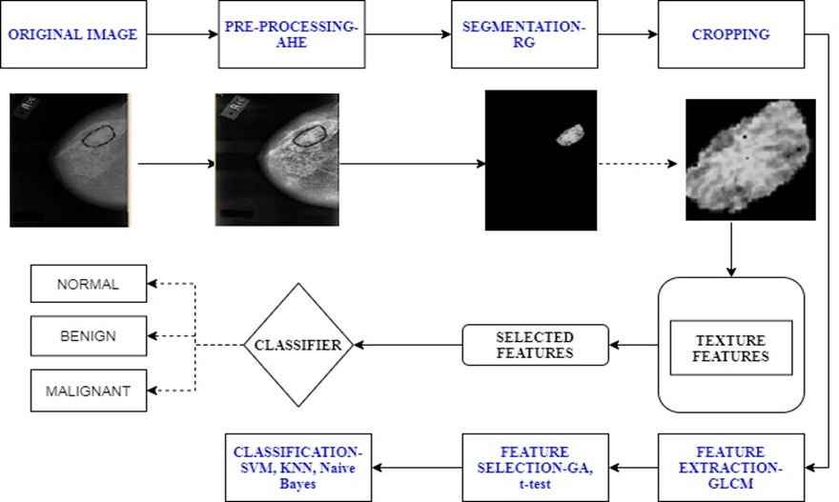
DATA FLOW DIAGRAM
Figure: BLOCK DIAGRAM

Slide 14
IMPLEMENTATION OF MODULES
List of modules
Pre-processing
Segmentation
Feature extraction
Feature selection
Classification

Slide 15
PREPROCESSING
Totally 979 mammogram images are collected out of which 296 benign images, 334 malignant images, 349 normal images.
Preprocessing step is applied to the collected images.
Illumination conditions are not same while capturing an image.
Increasing the contrast level of the image.
It helps in image segmentation.
Preprocessing step is achieved by using Adaptive Histogram Equalization(AHE).
It works on small region in an image called tiles.
The range of gray-level in a low-contrast image get increased.

Slide 16
SEGMENTATION
It is the process of segmenting the needed portion from the pre-processed image
Goal : To simplify and/or change the representation of an image
More meaningful
Easier to analyse
From the segmented image , the features are get extracted for classifying the image
Technique : Region growing algorithm (RG)
It is a simple region-based image segmentation method
This approach is opposite of the split and merge approach
It starts with a seed pixel, growing by appending the seed, by its neighbor pixel, if they have similar properties.

Slide 17
FEATURE EXTRACTION
Goal : To convert the segmented image into representation, that describes its main features and attributes
The resulting representation is used as an input for classification technique.
Extracting the features based on texture properties :
Texture properties :
Powerful descriptor of an image
It associates the notion of texture with image properties such as smoothness , coarseness and regularity
Techniques : Gray Level Co-occurrence Matrix(GLCM)

Slide 18
Table 1. GLCM Features
Table 1 shows that the features which are extracted from RoI by using GLCM
Feature names
Entropy | Cluster Shade
Dissimilarity | Cluster Prominence
Contrast, | Autocorrelation
Inverse difference | Sum of Squares
Difference variance | Sum Average
Information measures of correlation(1) | Sum Variance
Maximum probability | Sum Entropy
Inverse difference normalized | Difference entropy
Information measures of correlation (2) | Homogeneity
Maximal correlation coefficient | Correlation
Inverse difference moment normalized

Slide 19
FEATURE SELECTION
Feature selection plays a major role in classification of mammogram images
The large number of features, is very difficult to determine which feature or combination of features achieves better classification accuracy rate
Goal: To select the set of optimal features which increase the accuracy rate and decrease the computational time
Technique : Genetic Algorithm(GA)
Fitness value is calculated to all the GLCM features
The feature with the best fitness values are combined randomly to produce offsprings
Each feature are selected and undergo cross-over and also subject to random mutations.
This process is repeated again and again and many set of features are produced that should create better solutions.

Slide 20
ALGORITHM
1) Input -> extracted feature set
2) Calculate fitness function (features, labels)
i. Parameter setting for k-value of KNN
K=5
ii. Parameter setting for number of cross validation
Kfold=2
iii. Perform KNN with k-fold cross-validation
iv. Select pairs of the best ranking chromosomes as parents
3) Apply crossover operator
Select two parents
Store parents
Random select one crossover point
Single point crossover between 2 parents
4) Apply mutation operator
5) Until terminating condition
6) Output-> optimal feature set

Slide 21
Table 2. GA Optimal Features
Table 2 shows the selected features by using GA. Nine features are selected as optimal features from twenty one GLCM features
Feature No. | Features
1 | Contrast
2 | Correlation
3 | Dissimilarity
4 | Maximum probability
5 | Sum Average
6 | Sum Entropy
7 | Difference variance
8 | Information measures of correlation
9 | Inverse difference normalized

Slide 22
Table 3. t-test Optimal Features
It shows the top 10 features with high t-score value
Feature no. | Features
1 | Contrast
2 | Cluster Shade
3 | Cluster Prominence
4 | Dissimilarity
5 | Homogeneity
6 | Maximum probability
7 | Difference variance
8 | Difference entropy
9 | Energy
10 | Entropy

Slide 23
CLASSIFIER COMPARISON ANALYSIS
Classification is the process to assign a class label to the testing data as normal, benign and malignant
Optimal features, which are selected using GA and t-test are given as input to the classifier
multiSVM, KNN, Naive Bayes classifiers are used to classify the mammogram images
Totally six combinations of classification are performed.
They are GA+multiSVM, GA+KNN, GA+Naïve Bayes, t-test+multiSVM, t-test+KNN, and t-test+Naïve Bayes.
First phase of classification problem is to train the model.
Second phase is to test the given data set.
Out of 979 mammogram images 550 images are consider as training set and 429 images are consider as testing set.

Slide 24
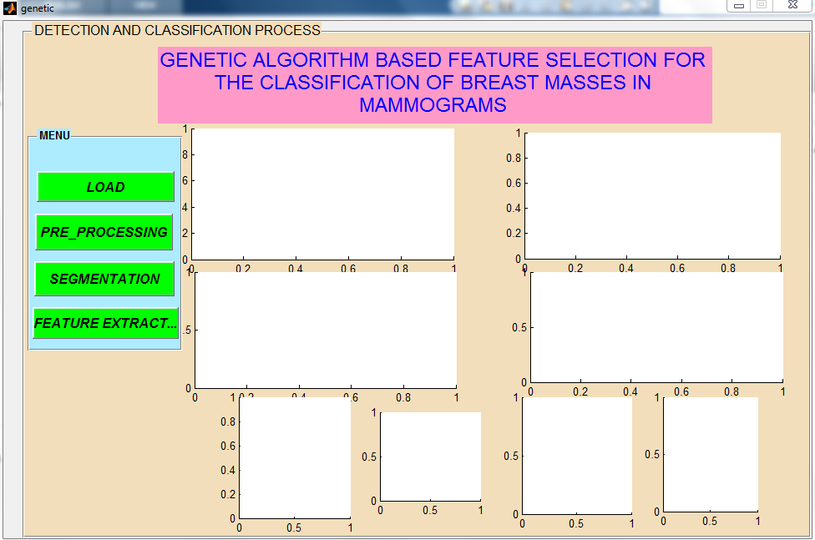
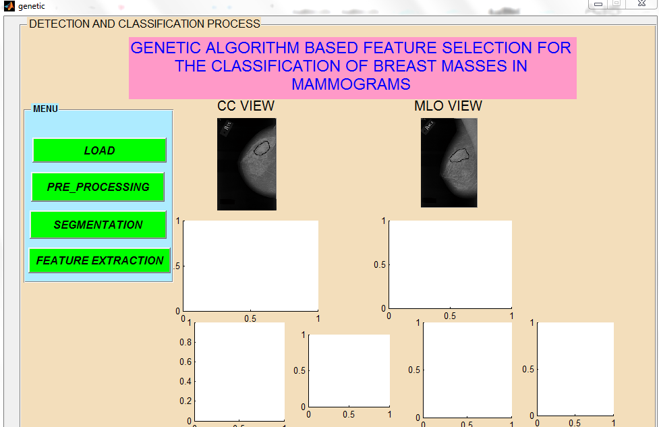
OUTPUT
Figure: GUI DESIGN
Figure : INPUT IMAGE

Slide 25
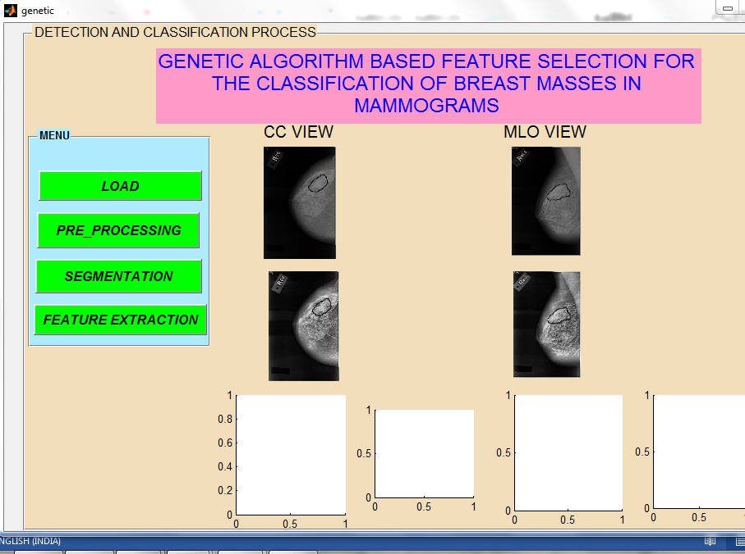
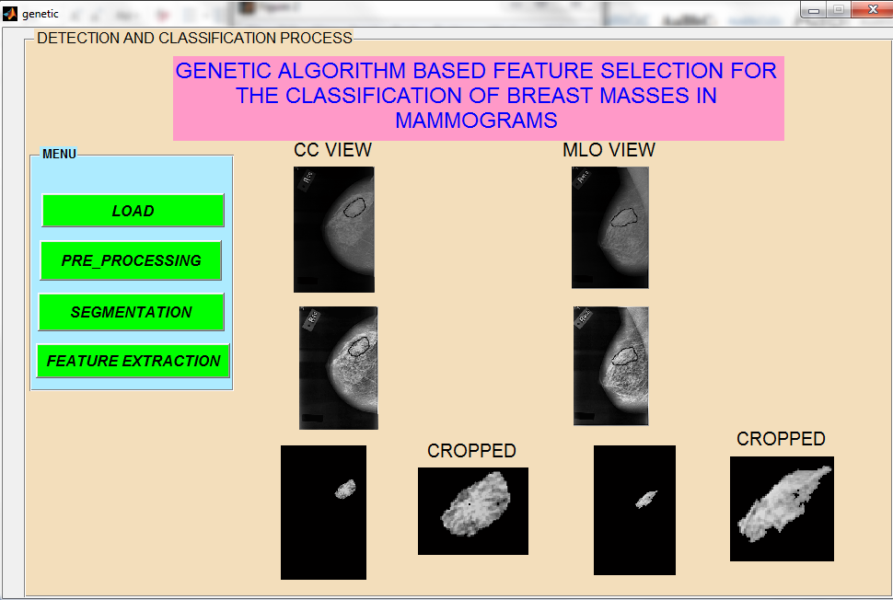
Figure: PRE-PROCESSED IMAGE
Figure: SEGMENTED IMAGE

Slide 26
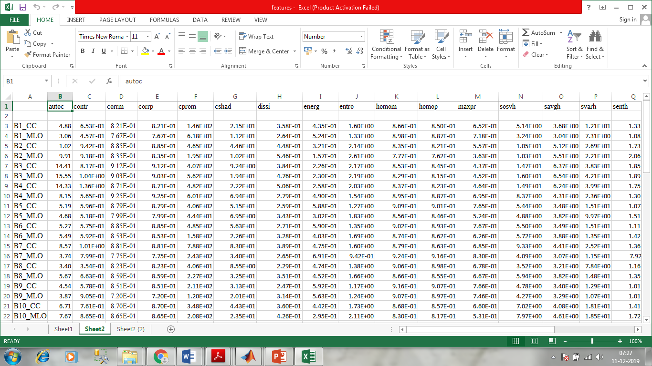
Figure : EXTRACTED FEATURES

Slide 27
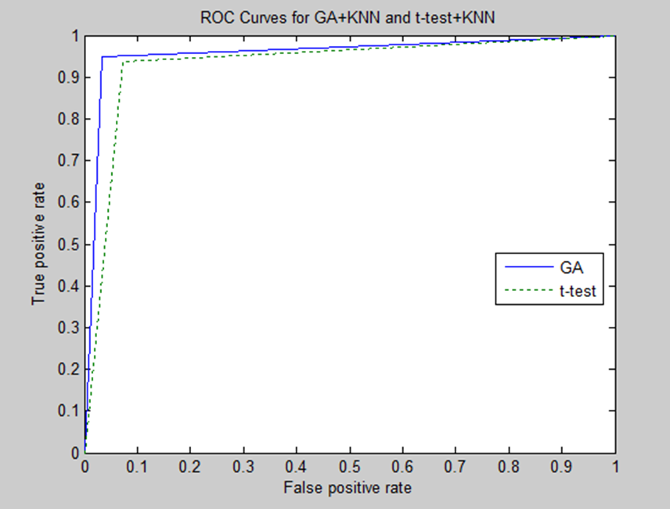
Figure: ROC CURVE FOR KNN CLASSIFIER

Slide 28
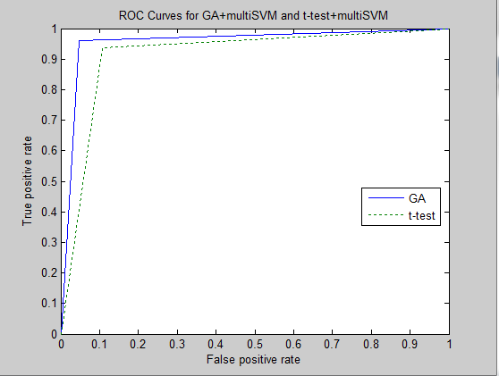
Figure: ROC CURVE FOR MULTISVM CLASSIFIER

Slide 29
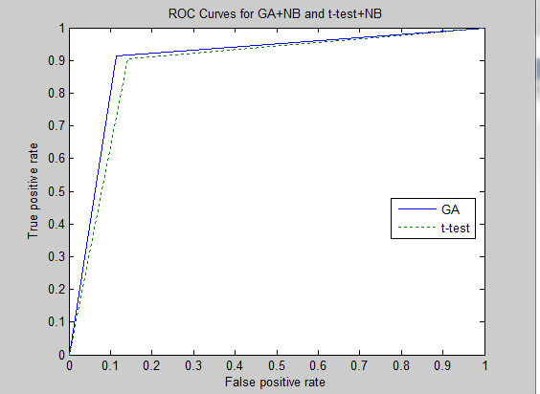
Figure: ROC CURVE FOR NAIVE BAYES CLASSIFIER

Slide 30
Table 5. Accuracy for each class
Feature Selector | Classifier | Benign | Malignant | Normal
Genetic Algorithm | kNN | 95.64 | 94.27 | 93.82
 | multiSVM | 95.58 | 93.06 | 92.18
 | Naïve Bayes | 88.59 | 92.56 | 91.65
t-Test | kNN | 91.81 | 92.70 | 92.25
 | multiSVM | 92 | 90.76 | 90.60
 | Naïve Bayes | 89.82 | 90.27 | 87.70
It shows the accuracy for each classes. It is observed that kNN classifier shows the higher values compared to the other two classifiers.

Slide 31
Table 4. Overall accuracy
From the table 4, it is concluded that, the Genetic Algorithm with the kNN classifier produced better results compared to the other classifiers and t-test selection algorithm.
 | Classifier
Feature selector | KNN | multiSVM | NB
GA | 92.07 | 90.68 | 86.95
t-Test | 88.81 | 87.64 | 84.38

Slide 32
Figure : Graphical Representation of overall accuracy

Slide 33
CONCLUSION
In this work, a 3-class classification system was proposed to classify breast masses in mammogram images into benign, malignant, and normal
Adaptive Histogram Equalization technique was used for pre-processing the collected images
The Region of Interest was segmented from the pre-processed image by using region growing algorithm
From the segmented image, the GLCM features were extracted for classifying the images
The optimal features were selected by using genetic algorithm and t-test. To evaluate the performance, three classifiers were used and the results were compared

Slide 34
These are, multiSVM, kNN, and Naïve Bayes classifiers. Totally, six combinations were evaluated
GA+multiSVM, GA+kNN, GA+Naïve Bayes, t-test+multiSVM,
t-test+kNN, and t-test+Naïve Bayes
From the experimentation it was concluded that the the combination of GA and kNN algorithm produced promising results
FUTURE ENHANCEMENTS
In future, the algorithm can be extended to work with more than 5000 images
An Automatic segmentation algorithm can also be developed

Slide 35
REFERENCES
ZEXIAN HUANG ,DAQI CHEN, “A Breast Cancer Diagnosis Method Based on VIM Feature Selection and Hierarchical Clustering Random Forest Algorithm”, IEEE Access VOLUME 10, 2022
Sweta Bhise , Simran Bepari , Shrutika Gadekar, “Breast Cancer Detection using Machine Learning Techniques”, International Journal of Engineering Research & Technology (IJERT) ISSN: 2278-0181 Vol. 10 Issue 07, July-2021
About Breast Cancer 2019. <https://www.cancer.org/cancer/breast-cancer/about/what-is-breast-cancer.html> [10 May 2019]
A discussion of conventional mammography 2019. Available from: <https://breast-cancer.ca/mammopics> [2 July 2019].
Aditya A. Shastri, Deepti Tamrakar, Kapil Ahuja. “Density-wise two stage mammogram classification using texture exploiting descriptors”. Expert systems with applications, Volume 99, pp.71–82, 2018.
Abdel-Nasser, M., Rashwan, H. A., Puig, D., & Moreno, A. “Analysis of tissue abnormality and breast density in mammographic images using a uniform local directional pattern”. Expert Systems with Applications, Volume 42, Issue 24, pp.9499–9511, 2018.
Oliver, A., Tortajada, M., Llado, X., Freixenet, J., Ganau, S., Tortajada, L.,Vilagran, M., Sents, M., & Mart, R. “Breast density analysis using an automatic density segmentation algorithm”. Journal of Digital Imaging, pp.1-9, 2018.

Slide 36
Rouhi, R., Jafari, M., Kasaei, S. and Keshavarzian, P. “Benign and malignant breast tumors classification based on region growing and CNN segmentation”. Expert Systems with Applications, Volume 42, Issue 3, pp.990–1002, 2017.
Beura, S. Majhi, B, & Dash, R. “Mammogram classification using two dimensional discrete wavelet transform and gray-level co-occurrence matrix for detection of breast cancer”. Neurocomputing, Volume 154, pp. 1–14, 2018.
Krishna Chaitanya Tatikonda, Chandra Mohan Bhuma, Srinivas Kumar Samayamantula. “The analysis of digital mammograms using HOG and GLCM features”. IEEE Trans. 9th International Conference on Computing, Communication and Networking Technologies (ICCCNT), 2018.
Yi-Chong Zeng. “Mammogram Density Classification using Double Support Vector Machines”. IEEE Trans. 7th Global Conference on Consumer Electronics (GCCE), 2018.
Routray I, Rath N P. “Textural feature based classification of mammogram images using ANN”, Proceedings of 9th International Conference on Computing. Communication and Networking Technologies (ICCCNT). IEEE. 1–6, 2018.
Amara Nedra, Muhammad Shoaib. “Detection and Classification of the Breast Abnormalities in Digital Mammograms via Linear Support Vector Machine”. IEEE 4th Middle East Conference on Biomedical Engineering (MECBME), 2018.
Basma A. Mohamed and Nancy M. “Automatic Classification of Masses from Digital Mammograms”. IEEE Trans. 35th National Radio Science conference (NRSC), 2018.
Al-Najdawi, N., Biltawi, M., and Tedmori, S., “Mammogram image visual enhancement, Mass Segmentation and Classification”, Applied Soft Computing, Volume 35, pp.175-185, 2015.

Slide 37
THANK YOU

